Slide 1
Multimedia Programming
Lawrence Goetz

Slide 2
What is multimedia?
Any combination of text, graphics, sounds, etc. that is viewed to you on a computer. Basically a mixture of medias.
When a user can choose the media content, then you have interactive multimedia (also known as Non-Linear).

Slide 3
Linear Multimedia
A movie or presentation that plays from start to finish with no interaction by the user.

Slide 4
Non Linear Multimedia
Interactive
Allows the user to select what content they want to access.
Your program should have some:
Human Computer Interface which is typically a UI (User Interface)

Slide 5
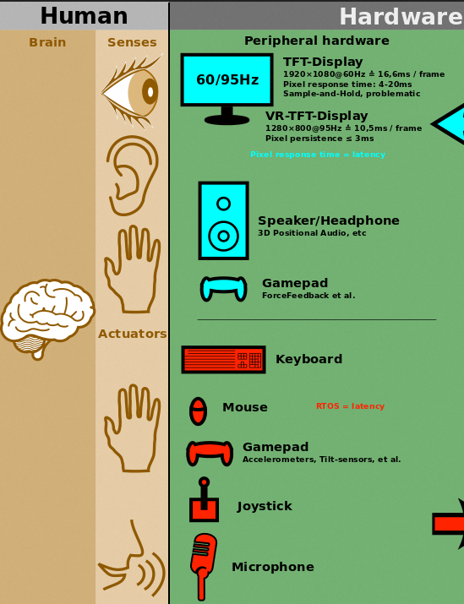
Notes:
https://commons.wikimedia.org/wiki/File:Linux_kernel_INPUT_OUPUT_evdev_gem_USB_framebuffer.svg

Slide 6
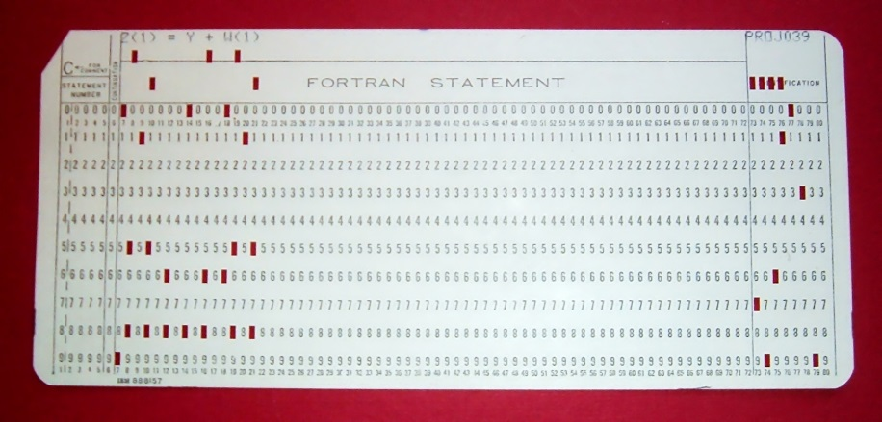
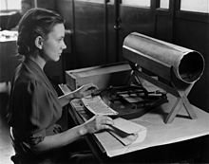
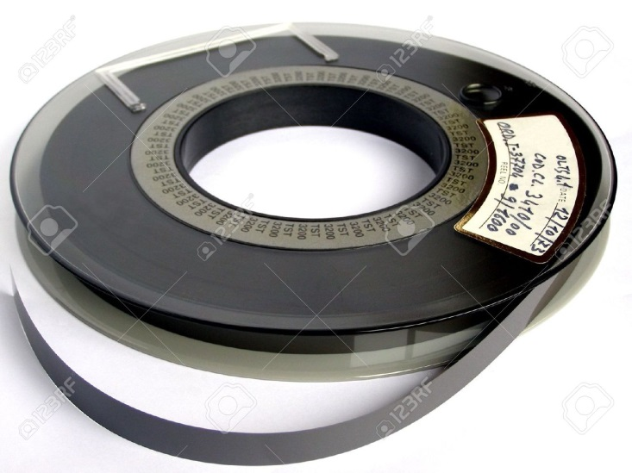
Batch Interface
Punch Cards
Magnetic Tape

Slide 7
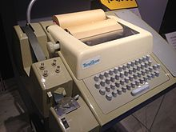
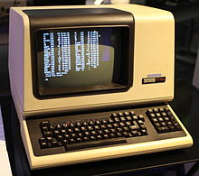
Command Line Interface
Keyboard with a printer output
Computer with a
CRT Monitor

Slide 8
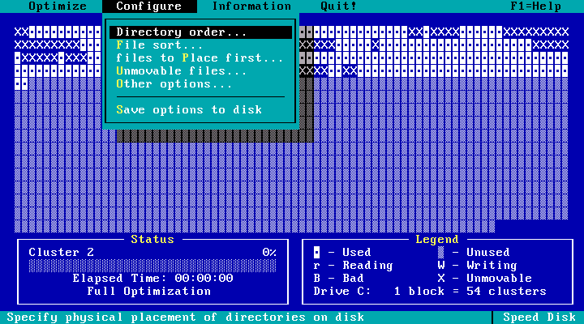
Text-Based User Interface

Slide 9
UI Over Time
Evolution of the interface
Text Menus by keys
Text by mouse. Drop down menus.
Icons and graphics
Touch Screen
Speech
Interesting I/O Devices

Slide 10
Spreadsheet
Visicalc
Lotus 123
Excel
Open Office

Slide 11
Videos
Tron: https://www.youtube.com/watch?v=AvayPCoHGFE
War Games:
https://www.youtube.com/watch?v=KXzNo0vR_dU
Minority Report https://www.youtube.com/watch?v=7SFeCgoep1c
Google Ad: https://www.ispot.tv/ad/Ijjh/google-heygoogle-lets-go-to-the-movies-song-by-the-ramones

Slide 12
Uses of Multimedia:
Business
Training
Video Conferencing
Presentations

Slide 13
Schools
Educational software
Simulations of hazardous topics. Like chemistry where chemicals can explode.
Look up databases of various topics, like encyclopedias.

Slide 14
Home
Game System
DVR
Streaming Device
VR - Oculus
Leap Motion: https://www.youtube.com/watch?v=_d6KuiuteIA

Slide 15
Public Places
Kiosks
ATMs
Advertising

Slide 16
Media Elements
Text
Graphics
Vector
Bitmap
Animations
Video
Audio

Slide 17
Compression
Lossy
Lossless

Slide 18
Input Devices
Keyboard
Mice/Trackball/Tablet
Touchscreen
Scanner
Camera
OCR (Optical Character Recognition) helps get printed text into electronic text.
Microphone (Voice Recognition)

Slide 19
Output Devices
Speakers
Monitor
Printers

Slide 20
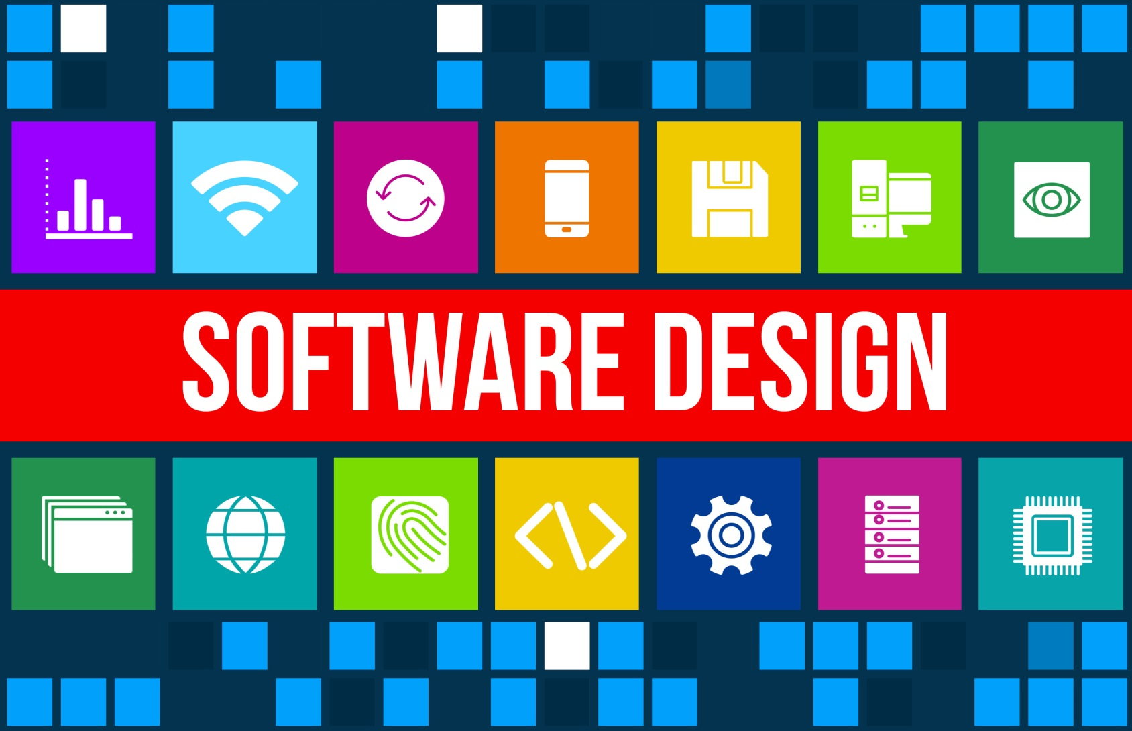

Slide 21
Product Overview
Vision of what you want
Goal
Target Audience (who'd use your product, or why)

Slide 22
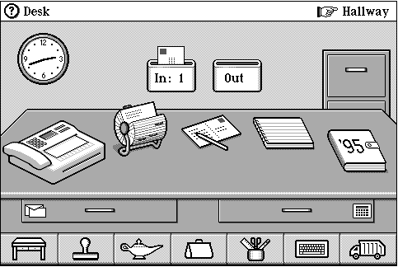
Treatment (how the program will be presented to the user).
Tone (serious, funny, formal, informal, etc)
Approach (how will the person interact with the program. The interface).
Metaphor (using something visual to represent the concept of the program).
Emphasis on multimedia.

Slide 23
Specification
Hardware and software requirements
Media elements
Functionality
User Interface

Slide 24
Storyboard & Navigation
Sketches &Spidergram
Linear (Sequential)
Nonlinear (Topical)
Exploratory (clicking on objects in a scene, like a game)

Slide 25
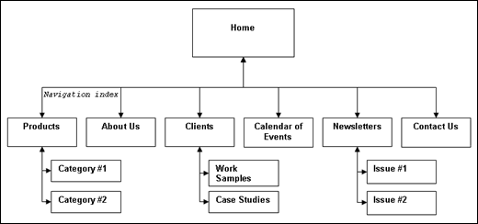
Storyboard

Slide 26
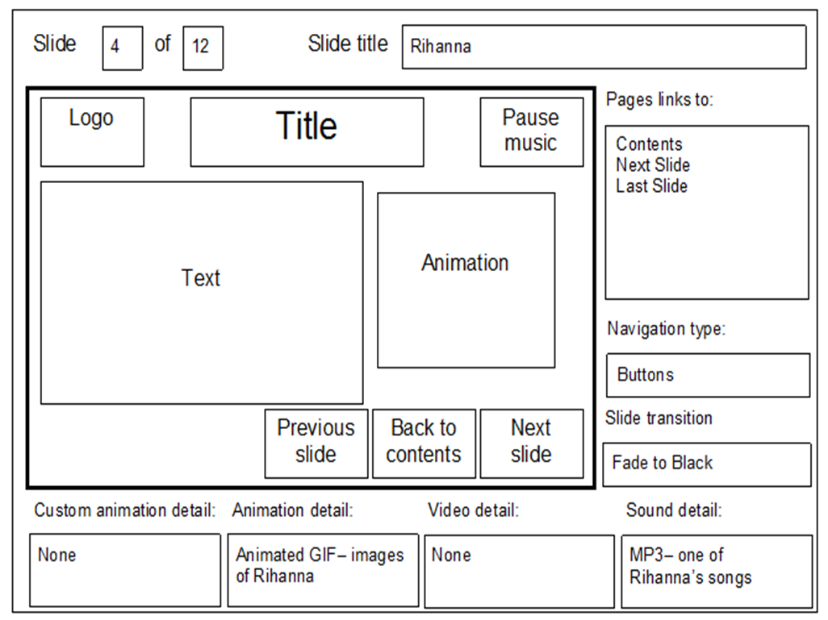
Part of the Storyboard

Slide 27
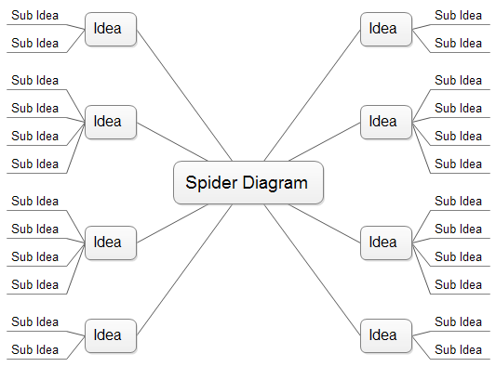
Spidergram

Slide 28
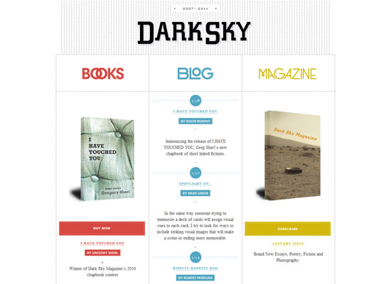
Designing the layout
Balancing the content on the screen:
Symmetrical Balance (mirror images of a center line)

Slide 29
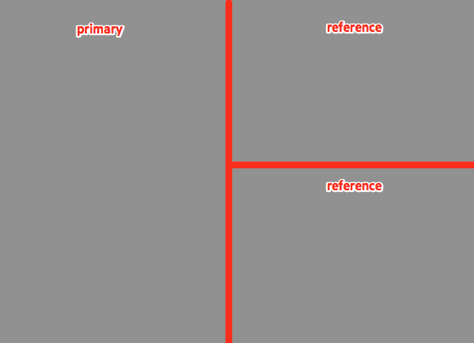
Layouts
Asymmetrical Balance (center line, no mirror images)
No Balance (any arrangement on the screen).

Slide 30
Layouts
Unity (keep the interface unified across your screens)
Movement (the flow at which people will read the screen).

Slide 31
Developing Content
Reusing existing content vs. hiring someone to create new content
Database of elements used in your project

Slide 32
Authoring the title
Programmer and interface designers need make sure of the specifications

Slide 33
Testing the program
Usability testing (users test the program and give feedback about the use of the program).
Check that the specifications of the program work.

